Slide 1



Introduction to Python
for developers
Excellerate

Slide 2

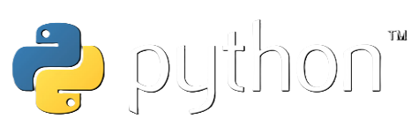
Course content
Session 1:
- Intro & Python IDEs
- General & basic syntax
- Variables
- Selection
- Loops
- Lists
Session 2:
- Functions
- Dictionaries
- Modules
- Files
- Classes
Session 3:
- APIs with Flask web framework
Python has grown to become one of the most widely used languages in the world, due to its simplicity and flexibility. The language is used in everything from web development, business intelligence, and machine learning. In the course, you will receive an introduction to basic syntax and various data structures. The course also concludes by demonstrating how a simple API can be created using the Flask framework.

Slide 3

Implementation of the course
- Prerequisites & expectations
- Lecture/session format
- Material
- Attendance - Certification exam

Slide 4
Course content
Session 1:
- Intro & Python IDEs
- General & basic syntax
- Variables
- Selection
- Loops
- Lists
Session 2:
- Functions
- Dictionaries
- Modules
- Files
- Classes
Session 3:
- APIs with Flask web framework
Python has grown to become one of the most widely used languages in the world, due to its simplicity and flexibility. The language is used in everything from web development, business intelligence, and machine learning. In the course, you will receive an introduction to basic syntax and various data structures. The course also concludes by demonstrating how a simple API can be created using the Flask framework.

Slide 5

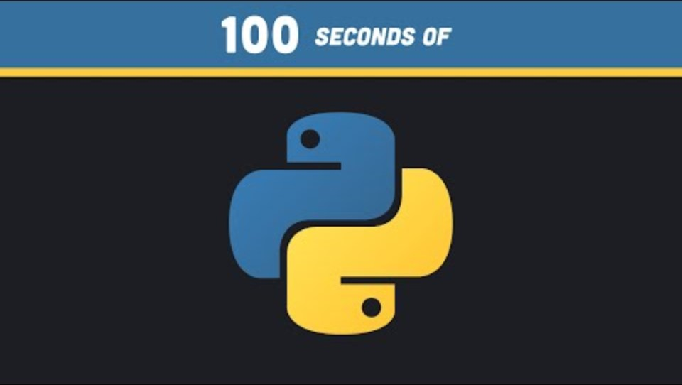

Let’s dive in!
Youtube: Fireship’s ”Python in 100 Seconds” (intro)

Slide 6

Python IDEs
Some of the popular ones:
- Visual Studio Code (VSCode) - https://code.visualstudio.com/docs/python/python-tutorial
- Jupyter Notebook
- Spyder
- PyCharm
- Atom
- Sublime Text
- Thonny
- Replit

Slide 7
About Python
- Current Version: 3.12
- High-Level, Interpreted Language
- Multi-Paradigm: Supports multiple programming paradigms, including procedural, object-oriented, and functional programming, making it versatile for various types of projects
- Dynamic Typing (you don't need to declare the type of a variable when you create one)
- Extensive Standard Library: Comes with a large standard library that includes modules for everything from file I/O to networking, XML processing, and much more
- PEP 8: Recommends coding style guidelines (PEP 8), helping to maintain readability and uniformity across Python codebases.
- Cross-Platform Compatibility: Runs on multiple systems like Windows, Linux/UNIX, and MacOS
- Applications: Widely used in various domains, including web development, data analysis, artificial intelligence, scientific computing, and automation

Slide 8
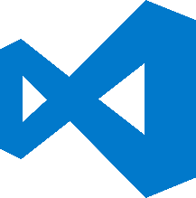
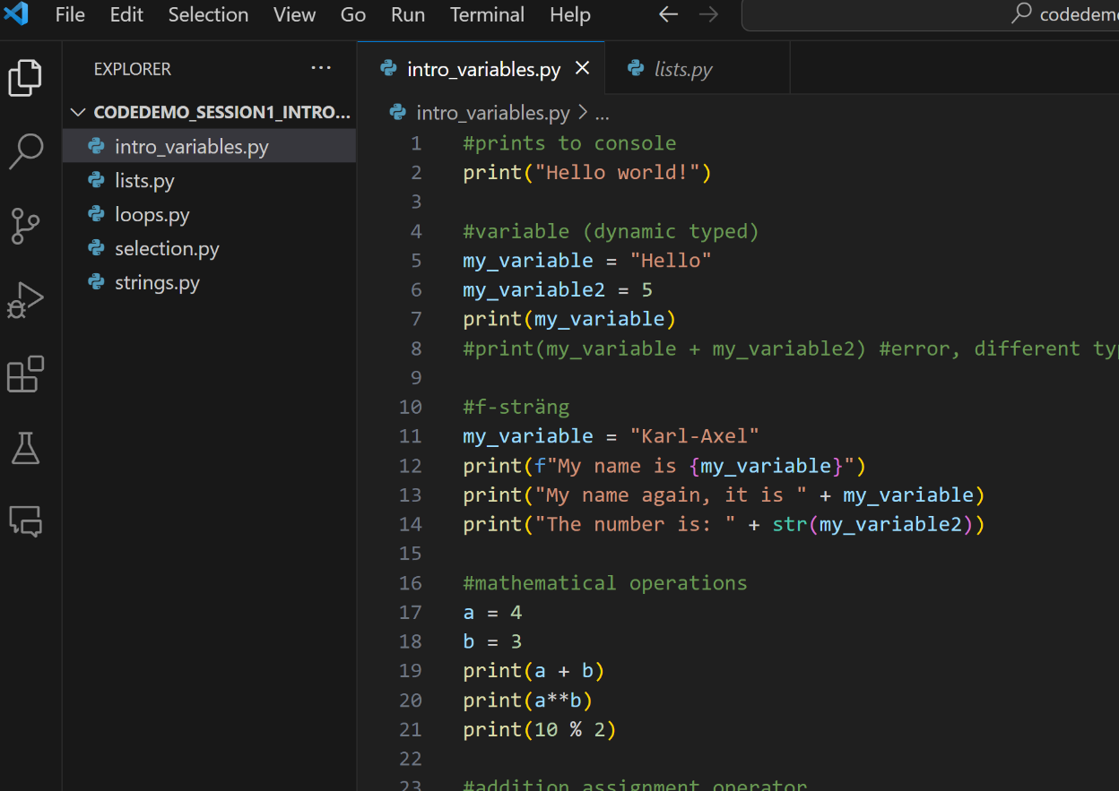
Code demo! – session 1
Code examples in Visual Studio Code with:
- General & basic syntax
- Variables
- Loops
- Lists

Slide 9

Workshop - session 1
- Work in groups of 3 (breakout rooms Teams)
- ”Pair programming” in Replit web-IDE
- Exercises (and solution proposals) sent in chat (just do as many tasks you have time for 👍)

Slide 10

Thank you for today!
Today we looked at:
- Intro & Python IDEs
- General & basic syntax
- Variables
- Selection
- Loops
- Lists
Next time - session 2:
- Functions
- Dictionaries
- Modules
- Files
- Classes
(session 3)
- APIs with Flask web framework
- How did it go?! 😃
- Questions/reflections?

